Slide 1
ÖZNUR YANAR
20110602255

Slide 2
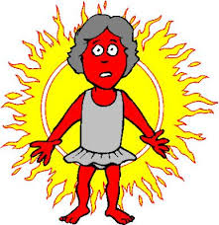
FİRST AİD SUNBURN

Slide 3
Signs and symptoms of sunburn usually appear within a few hours of exposure, bringing pain redness,swelling and occasional blistering. Because exposure often affects a large area of your skin, sunburn can cause headache, fever and fatigue

Slide 4
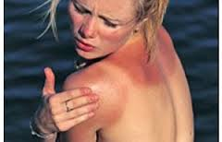
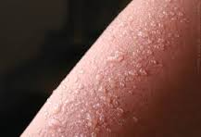

Slide 5
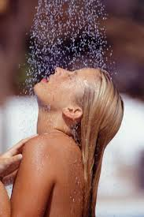
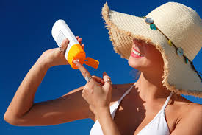
IF YOU HAVE A SUNBURN
Take a cool bath or shower adding ½ cup of cornstarch, oatmeal or baking soda to your bath water may provide some relief.
Apply an aloe vera lotiun several times a day.

Slide 6
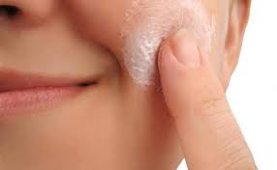
Leave blisters intact to speed healing and avoid infection.If they burst on their own, apply an antibacterial oıntment on the open areas.

Slide 7
If needed, take an over the counter pain reliever such as aspirin, ibuprofen(Advil,motrin,others) naproxsen(aleve) or acetaminophen(tyleon,others). Dont give children or teenagers aspirin. It may cause reye’s syndrome, a rare but patentially fatal disease

Slide 8
THANK YOU ☺

