Slide 1
German Education System and Foreign Language Teaching
Gizem UZUNDURDU

Slide 2
Fedaral Republic of Germany
Population: 82.79 million (2018)
Capital: Berlin
Area: 357,386 km2
Income per capita: $46,653 (World’s fourth largest)
Literacy rate (15 and above) : %99
Pisa results : 2000 – 20th in 31
2018 – 18th in 71
Compulsory Education: 9 years
A school year: 188 days
9th best English speaking country

Slide 3
School Types
free
* 6% of kids attend
* Some bilingual
*164 schools (2015)
* Quality education
State Schools
Private Schools
International Schools

Slide 4
* The Federal Republic of Germany includes 16 states. States and Their Curricula
Each state chooses their own programs and materials while federal government only defines the general standards. (competencies)
After the bad results in 2000, the ministry of education of all states came together and set some standards to make the education equal and similar in all states.

Slide 5
EDUCATION SYSTEM
1- Kindergarden
Ages 3-6
5 hours a day
2- Primary School - Grundschule
Ages 6-10
4 years
Not compulsory
96% of kids attend
Main focus: reading, writing, arithmetic, independent thinking/learning/working
In the morning: teaching in the afternoon : activity (not compulsory)
German, art, music, sport, math and one foreign language (mostly English) is compulsory
Foreign language learning starts at 3rd grade
20-29 lessons (45mins) weekly

Slide 6
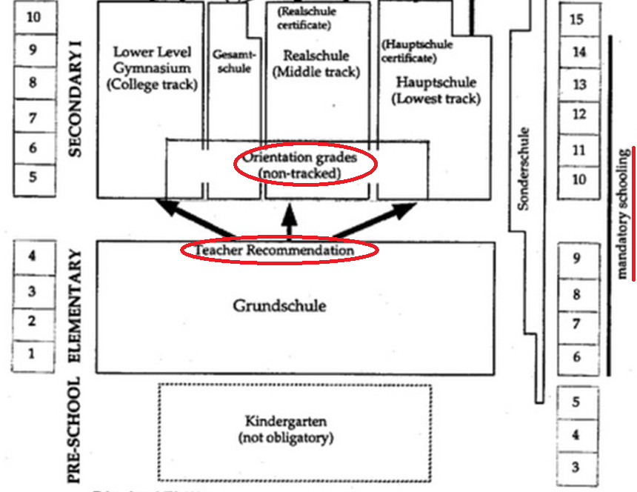

Slide 7
3-Secondary Education
2 Years of Orientation (grade 5 and 6)
A phase in which teachers decide on which secondary school is appropriate for the student.)
Types of Secondary Schools
Aim: To provide the basis for leading an autonomous, responsible and participatory life within industry and society.
Hauptschule: Basic and vocational education (4-5years) (compulsory) Mostly foreign students
Realschule: for intermediate students (5-6 years) more extensive education leading to a vocational or university entrance qualification
Age: 10-16
Gymnasium: * intensive and in-depth general education (7-8 years) * preparation for university studies, and scientific work * no need to take Abitur(university enterance exam)
Gesampshule: Combination of all 3 schools
* Latin is compulsory
* 2 foreign languages are compulsory
* 30-32 lessons weekly

Slide 8
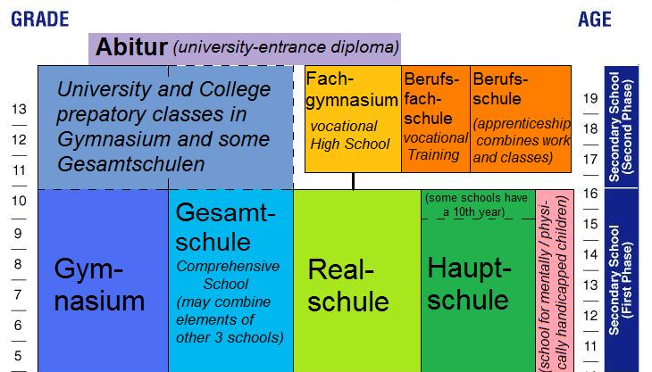
3-Secondary Education

Slide 9
Sample grade 10 Gymnasium timetable (Bavaria, Humanist)
Time | Monday | Tuesday | Wednesday | Thursday | Friday
08.00–08.45 | English | Physics | Biology | Physics | Greek
08.45–09.30 | History
09.30–09.40 | break
09.40–10.25 | Latin | Greek | Mathematics | Latin | Economics
10.25–11.10 | German
11.10–11.30 | break
11.30–12.15 | Music | Mathematics | Geography | German | Biology
12.15–13.00 | Religious studies
13.00–14.00 | break
14.00–14.45 | Arts |  | Intensive course
14.45–15.30 | Intensive course |  | Greek
15.30–16.15 | PE
16.15–17.00 | PE
(*To take religious instruction is decided by the student after 14)
*In gymnasium schools, at least 2 foreign languages are compulsory.
** Latin and an immigrant’s own language is also considered as foreign language.

Slide 10
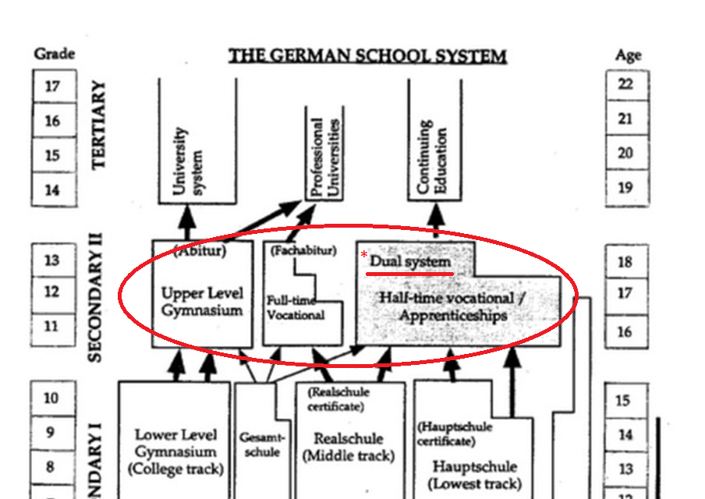
4-High School ( Secondary education 2nd phase)
Dual System : Students work in a
campaign and study in a vocational
school at the same time.

Slide 11
Foreign Language Teaching
General Information
Language learning policy : To promote linguistic and cultural diversity and to prepare students for the international working world.
Foreign language is predominantly English and French.
Second language learning starts at 3rd grade. (Some states at 1st grade)
National language is the language of science.
Multilingual approach in education, study and professional life
Some schools(private) are offering bilingual modules or specialist courses (CLIL).
Certain subjects, such as mathematics or history, are taught not only in the first language, but also in a foreign language (mostly English).
European Council’s goal: every European citizen be able to speak at least two foreign languages.

Slide 12
A Sample Book Used in Germany

Slide 13
Some Key Characteristics
Important skills are listening and speaking.
Grammar is not explicity taught.
L1 can be used because German and English have similarities, so comparision helps.
Grammar is learnt by lots of oral and written practise.
Learning process starts by listening.

Slide 14
A sample activity from a state school English textbook to teach grammar

Slide 15
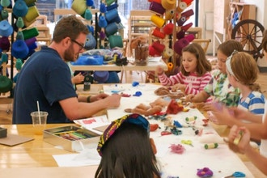
English Teaching in Primary Level
The focus : understanding, making oneself understandable and communicating
The high level of willingness to speak and to strengthen and maintain their motivation in meaningful language situations
Language in a playful, creative, experimental and emotional way
Working together in thematic units or projects
Teamwork and social, personal and methodological skills

Slide 16
Autonomy and individualism
Portfolios or individual learning maps
Realistic self-assessment
Autonomous individuals
*Regular diagnostics
*to perceive each child with his/her skills and offer individual support

Slide 17
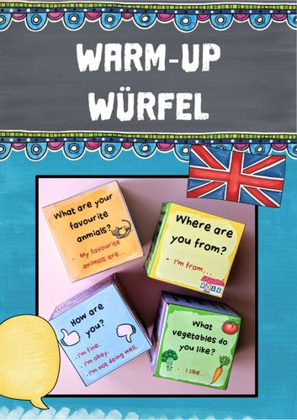
Real life situations, authentic materials ( songs, poems) action based methods
German only if it is absolutely necessary
Students are expected to be A1 to complete the primary education.
Grammar is not taught systematically and explicitly. It’s taught by lots of oral and written practise.

Slide 18
1-Listening and Speaking
Primary focus is on the development of listening comprehension and speaking (stoytelling,singing)
Ortography has an important place.
After listening, conscious perception of
language (noticing processes) is necessary,
therefore some implicit parts are needed.
Early verbal utterances are avoided
(waiting until the first signs of a desire to speak)
functional communicative
competencies have a key role

Slide 19
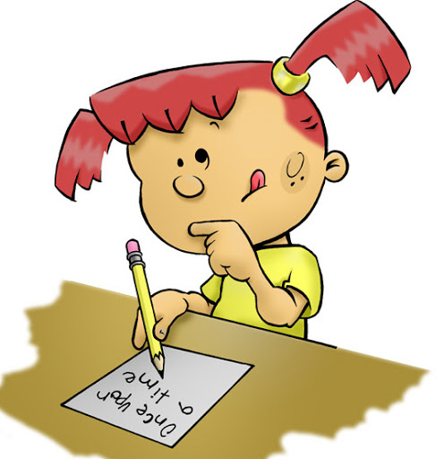
2-Reading and Writing
Reading and writing have a secondary and supportive function.
These skills are developed in the second year of learning.
Reading is essentially to be understood as reading along with or recognizing typeface images.
holistic reading procedures and word-picture assignments or simple labeling
Writing is based on a template and writing on it in 3rd grade.
Writing skills are included taking into account the performance
of the learning groups and the learning dispositions of individual
students. (latest at the beginning of 4th grade)
Creative writing activities (such as writing a text by looking at a
picture) are used a lot in higher levels.

Slide 20
A Sample
Bremen State 3rd and 4th Grade English Lesson Curriculum

Slide 21
* Not necessarly be taught

Slide 22
Communicative Competencies
Skills | Basics | GENRES and TEXT TYPES
Listening | • identify linguistic statements • Develop global understanding • Show understanding of details | Continuous texts Non-fictional texts Dialogue, role play, description, report, (game) instructions, work instructions, rules, communication Fictional texts Fairy tales, picture story, poem, story, picture book, interview, lyrics, rhyme Discontinuous texts Profile, table, list, etc.
Reading | • Recognition of words and sentences (full-word recognition) • Read along • extract simple text statements show global understanding of text
Writing | • write your own texts based on models (creative copying) • Write texts based on a template
Speaking | • express your own speaking intentions • correct pronunciation
Voice Agent | reproduce a spoken or written familiar text in the mother tongue
Communicative Competencies
*The competencies and areas of competence are
based on the educational standards agreed by the
Conference of Ministers of Education for all federal states.

Slide 23
Content - the living environment and the interests of children

Slide 24
For more information
https://www.bildungsserver.de/Lehrplaene-400-de.html#Bremen
https://www.lis.bremen.de/sixcms/detail.php?gsid=bremen56.c.15219.de
https://www.goethe.de/en/spr/mag/21066876.html
https://files.eric.ed.gov/fulltext/ED577138.pdf
https://www.studying-in-germany.org/german-education-system/
https://files.eric.ed.gov/fulltext/EJ1100375.pdf
Gizem Uzundurdu
uzundurdugizem@gmail.com

